Slide 1
2021A2122025
虚空数据神作
Fungal Decomposition Modeling via Stochastic Gradient
Descent and Cellular Automata

Slide 2
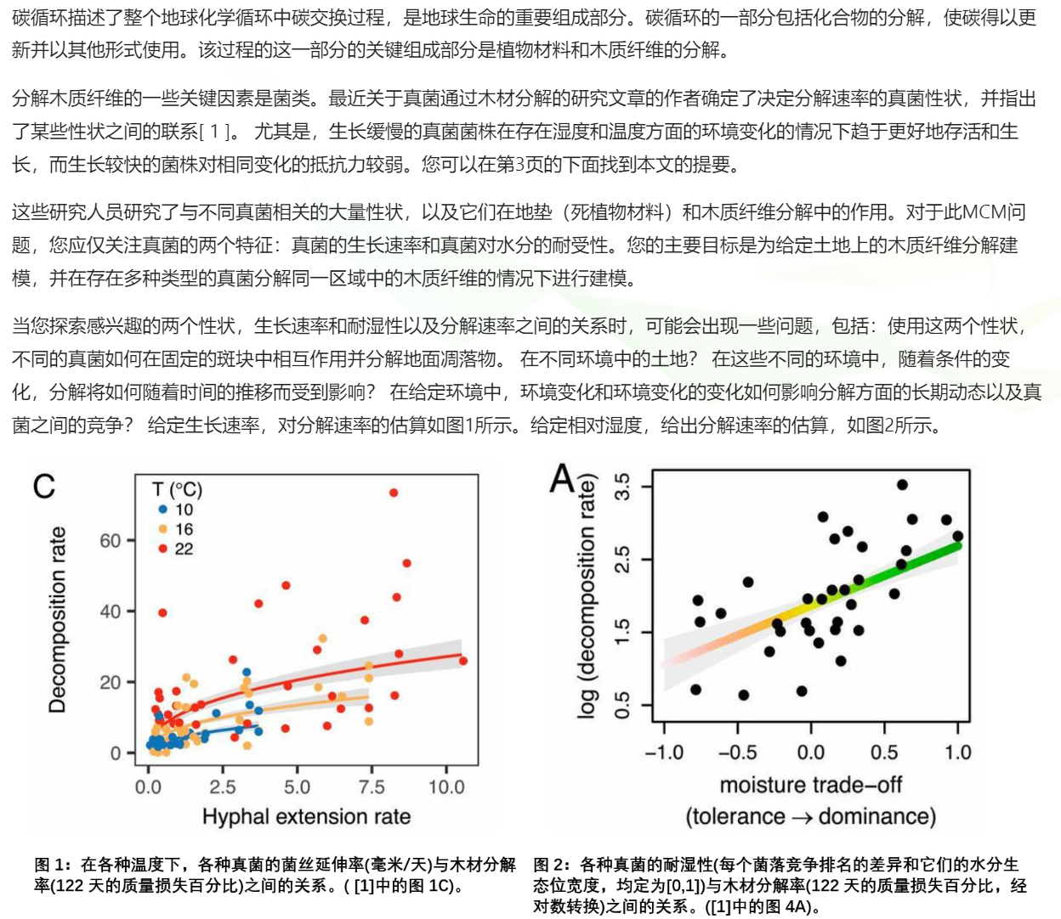
题目回顾

Slide 3
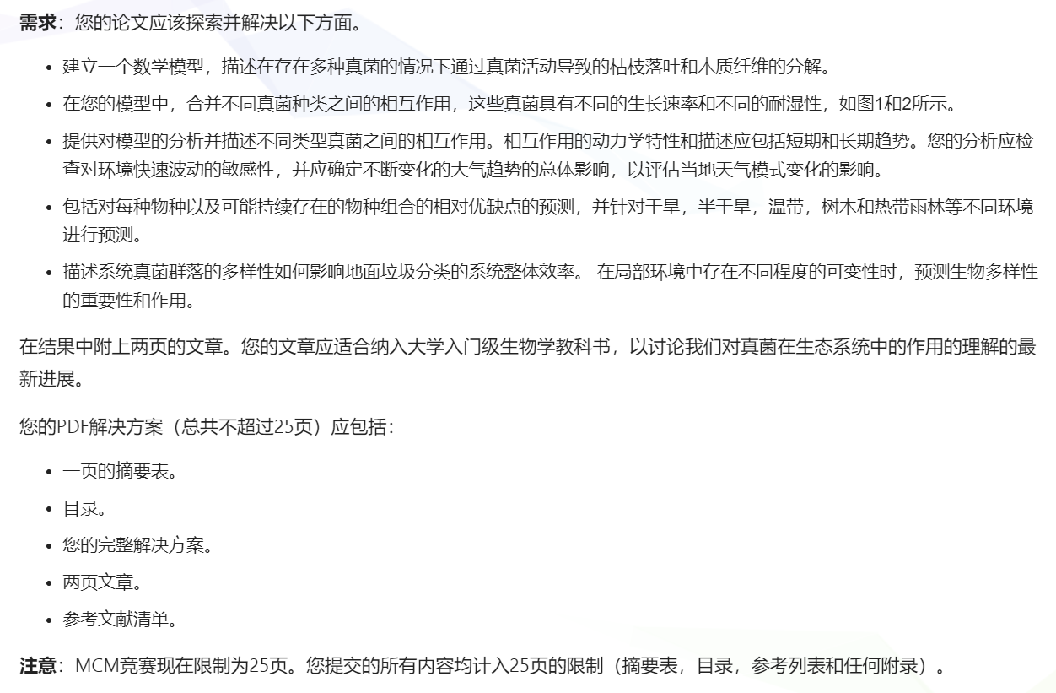

Slide 4
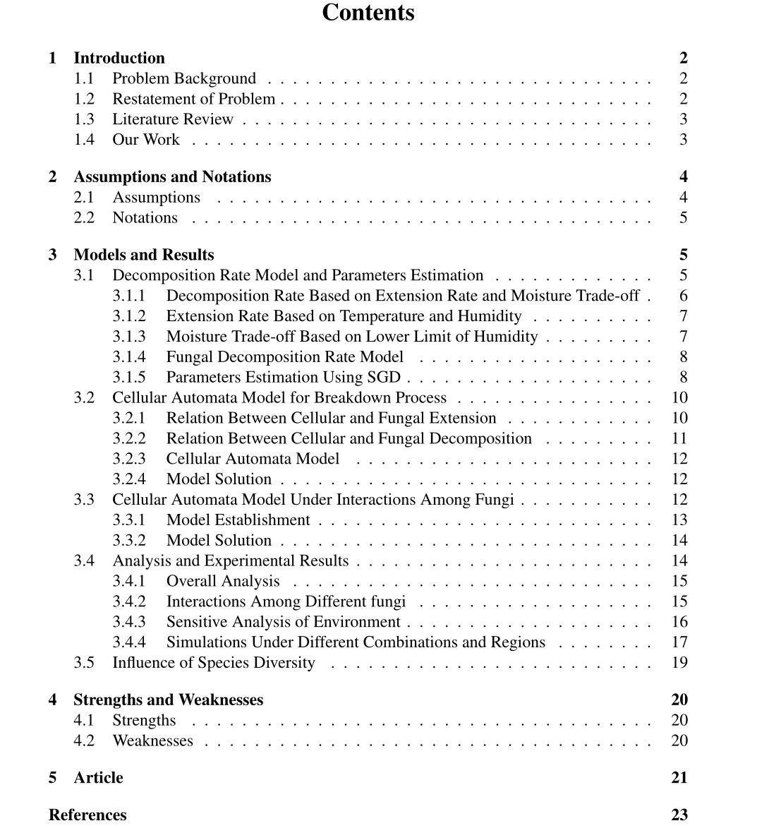
文章结构
页码从第2页开始，共25页

Slide 5
摘要写了什么
Fungus plays an important role as decomposers in the ecosystem. However, the efficiency of
fungal growth and decomposition is influenced by the environment and the interaction among
different species of fungi. Therefore, the study of factors affecting fungal activity is important.
问题背景
In this paper, we establish relation models among the factors that affect the extension rate
and decomposition rate of the fungi. Based on the relation models, we introduce the cellular
automata model to simulate the growth and decomposition of multiple species of fungi.
工作内容概括
Specifically, we first establish the extension rate model. The extension rate is modeled as
Arrhenius relation to the temperature and the humidity. Based on the extension rate model, we
establish the decomposition rate model. The decomposition rate is determined by extension
rate and moisture trade-off, where the relation is nonlinear. To estimate the parameters in the
nonlinear decomposition rate model, we establish an optimization model that fits the collected
decomposition rate data. The stochastic gradient descent (SGD) algorithm is utilized to solve
the nonlinear optimization problem. The stable convergence behavior shows the effectiveness
of the algorithm.
问题1

Slide 6
Based on the decomposition rate model, we establish the cellular automata model to simu-
late the growth and decomposition of the fungi. The extension rate and decomposition rate are
utilized to determine the rules of cellular automata. The simulation results show that under the
same environment, the number of different species of fungi increased significantly at the first
5 − 10 days. Then, after about 10 days of extension, the number of fungi decreases to a certain
extent and then stabilized after about 40 days. The decomposition rate after 122 days is 0.68.
问题1
Next, we describe the interactions among different species of fungi by competitive relation-
ship. To describe the competitive relationship, we propose a definition to measure the reduction
of the extension rate. Based on this definition, we establish the cellular automata model under
fungal interactions to simulate the fungal activity under interactions. The results show that after
considering the interaction, the number of different types of fungi is considerably decreased by
an average percentage of 33.65%. And the decomposition rate after 122 days is 0.39, which is
42.69% lower than that of the situation without competition.
问题2
Afterward, we analyze the influence of fungal interactions. In the short term, the interaction
between different types of fungi is not obvious. In the long-term, the influence is significant
due to the shortage of nutrients. Afterward, the sensitivity of our models is studied. We show
that our models are sensitive to 8% change of temperature and humidity. Then, the analysis
of combinations of fungi and different environments are included. The dominant and disad-
vantaged species in different situations are obtained, e.g., Trichoderma becomes the dominant
species in the tropical rain forest after 122 days with the decomposition rate of 68.29%. At last,
we analyze the importance of biodiversity. The results show that biodiversity is important to the
efficiency of fungal decomposition, where the decomposition rate of fungi under multi-species
is 2.89 times higher than that of single species
问题3，4，5
Keywords: Fungal decomposition, Stochastic gradient descent, Nonlinear, Cellular automata

Slide 7
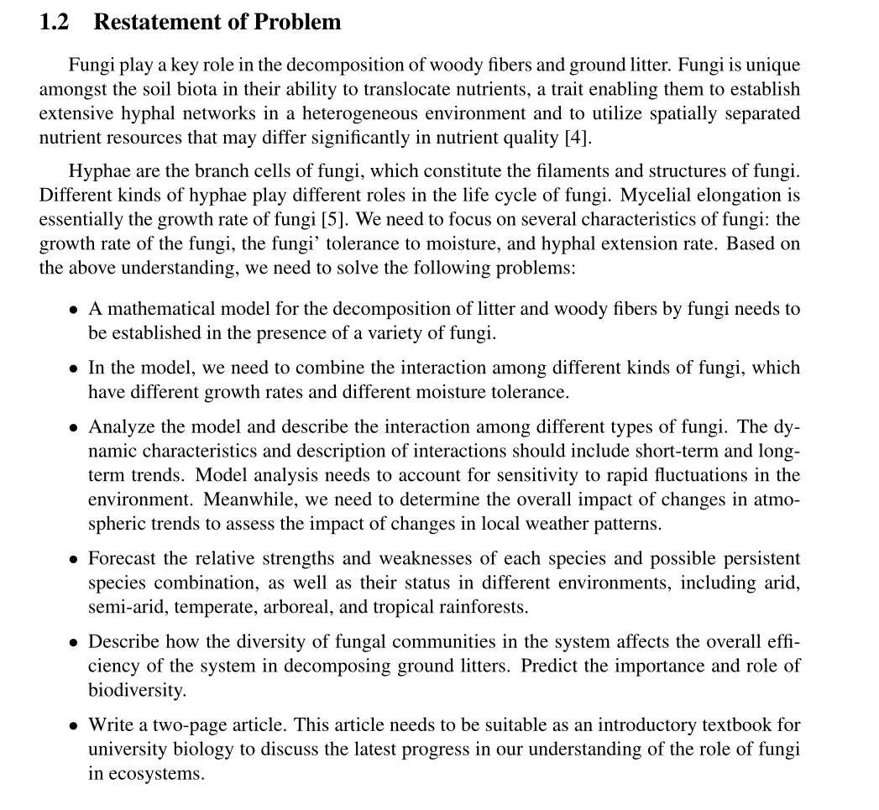
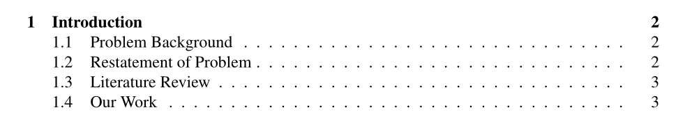
Therefore, fungi play an important role in material transformation [3].
前五点对原题目的换一种表述，最后一点是
把要写article这件事说成一个任务

Slide 8
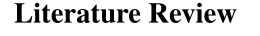
The most obvious identity of fungi is decomposer. According to Chen M R [6], litter de-
composition generally includes three stages: leaching stage, crushing stage, and organic matter
catabolism stage. Among them, the leaching stage refers to that the soluble matter in the litter
is washed away by water. Physical comminution, for instance, animal chewing, alternation of
soil drying and wetting, freezing and thawing, precipitation, and other factors can crush the tree
residues in varying degrees [6, 7]. Metabolism refers to the transformation of more complex
organic compounds to simple salt and water molecules.
分解的三阶段
The catabolism of organic matter is generally accomplished by microorganisms. Y u shuling
[8] proposed that fungi, especially filamentous fungi, play an important role in litter decompo-
sition. Findlay et al. [1] pointed out the hyphae of fungi can penetrate into plant debris and
secrete extracellular enzymes to degrade recalcitrant substances (such as lignin) contained in
the litter, so as to soften plant debris, change the structure and chemical composition of litter,
which is conducive to the further colonization of bacteria and other microorganisms and the
feeding of soil animals [9, 10]
真菌的分解机理
The complete decomposition of litter is completed under the action of various litter decom-
posing enzymes [11]. Dick [12] showed that the activities of litter decomposing enzymes were
significantly positively correlated with the microbial biomass. Zhang Ruiqing et al. [13] mea-
sured a variety of enzymes related to the carbon cycle in the process of litter decomposition in
the tropical rain forest, and pointed out that enzymes related to the carbon cycle can be used as
an important indicator of organic matter decomposition.
酶的作用与碳循环相关的酶可以作为有机质分解的重要指标。

Slide 9
Wang Qibing et al. [14] claimed that the decomposition rate of litter will increase with the
increasing temperature [15]. The research results of Liu Qiang and Vitousek [14, 15] showed
that the temperature will begin to decrease with the increasing altitude, and the decomposition
rate will be significantly reduced. Moore et al. [16] believed that on a large spatial scale, the
annual average temperature was considered to be the dominant climate factor affecting forest
litter decomposition. The decomposition rate of litter in each climate zone was tropical >
subtropical > temperate > cold temperate [17, 18]. Under the action of high temperature and
high humidity, the soil microbial activity in low latitude and low altitude areas is generally
higher, the decomposition rate of litter is faster, and the accumulation rate of forest surface
organic matter is slow. On the contrary, limited by low temperature, microbial activity in high
latitude and high altitude areas is generally low, litter decomposition rate is slow, and forest
surface organic matter accumulation is large [1, 16, 17].
环境气候因素的影响
年平均气温被认为是影响森林凋落物分解的主导气候因子。
文献综述这一段的作用主要是
第一：三个阶段的描述对后面假设有用，
第二：酶这个因素与后面的假设相关
第三：环境气候因素这一段比较不同地域，与题目中的要求相符
分解机理这一段对后面计算没影响，但是显得专业

Slide 10
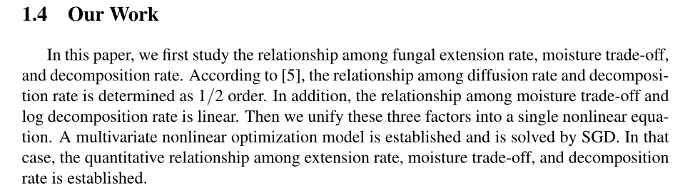
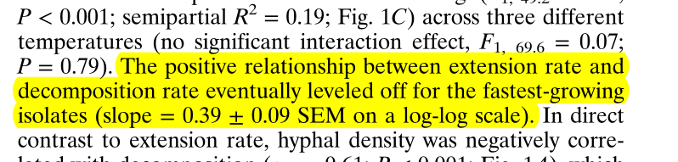
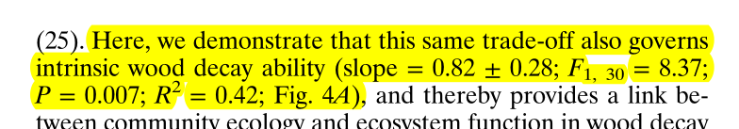

Slide 11
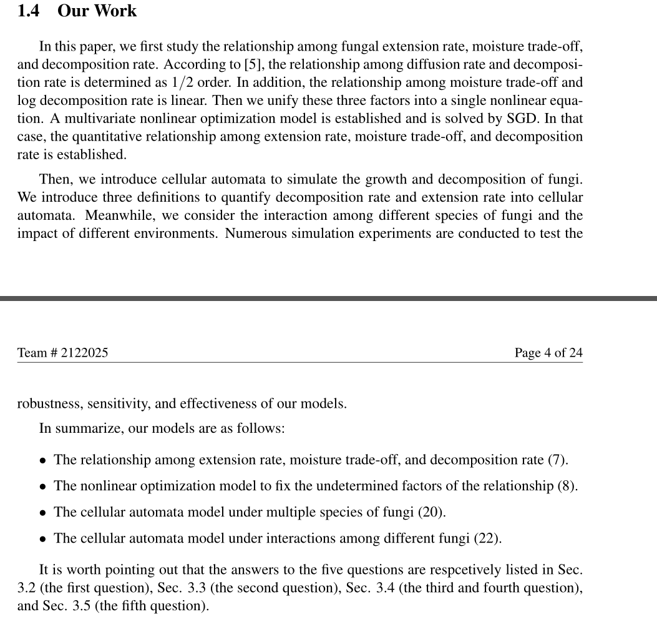
分总结构，先较为粗略的介绍数据的搭建，再做一个总结，再介绍每个章节解决的是那个问题

Slide 12
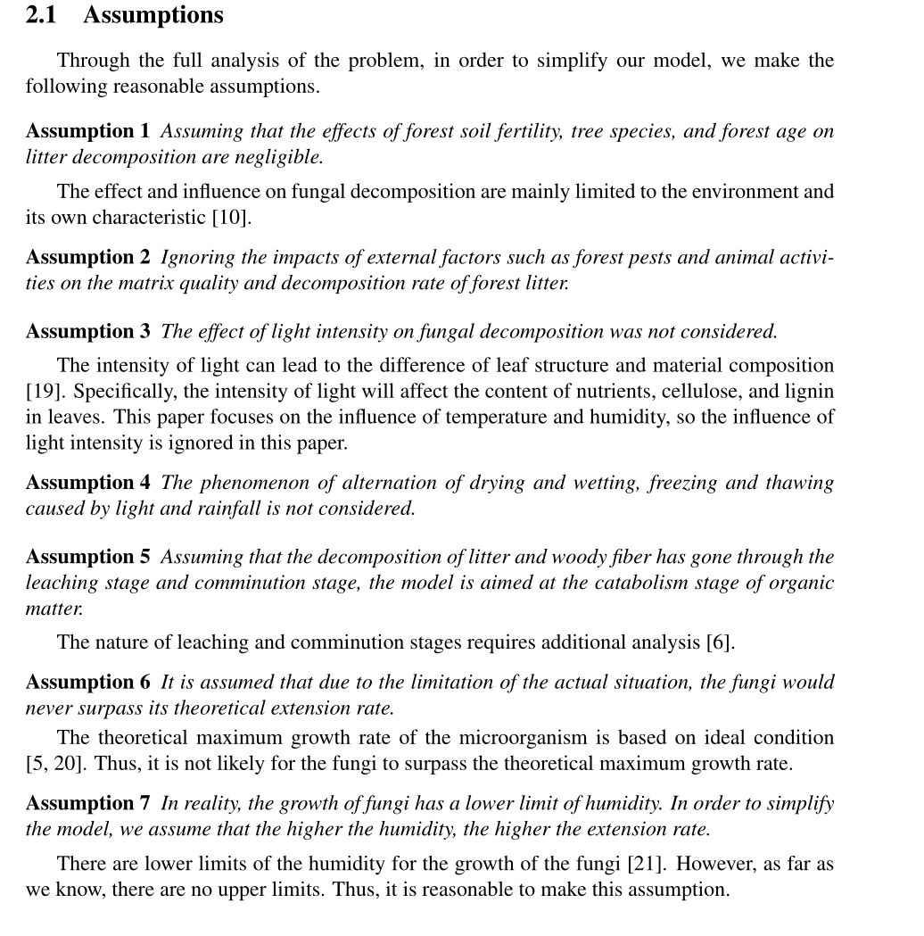
对应前面三个阶段

Slide 13
假设森林土壤肥力、树种和林龄对凋落物分解的影响可以忽略不计。
对真菌分解的作用和影响主要局限于环境及其自身特性[10]。
假设2忽略森林害虫、动物活动等外部因素对森林凋落物基质质量和分解速率的影响。
假设3未考虑光照强度对真菌分解的影响。
光照强度会导致叶片结构和物质组成的差异[19]。具体来说，光照强度会影响叶片中营养物质、纤维素和木质素的含量。本文主要研究温度和湿度的影响，因此忽略光照强度的影响。
假设4不考虑光照和降雨引起的干湿交替、冻融交替现象。
假设5假设凋落物和木质纤维的分解经历了浸出阶段和粉碎阶段，模型针对的是有机物的分解代谢阶段。
浸出和粉碎阶段的性质需要进一步分析[6]。
假设6由于实际情况的限制，我们假设真菌永远不会超过其理论扩展速率。
微生物的理论最大生长速率以理想条件为基础[5,20]。因此，真菌不太可能超过理论的最大生长速度。
假设7在现实中，真菌的生长有一个湿度下限。为了简化模型，我们假设湿度越高，扩展率越高。
真菌[21]生长的湿度有下限。然而，据我们所知，没有上限。因此，做出这样的假设是合理的。

Slide 14
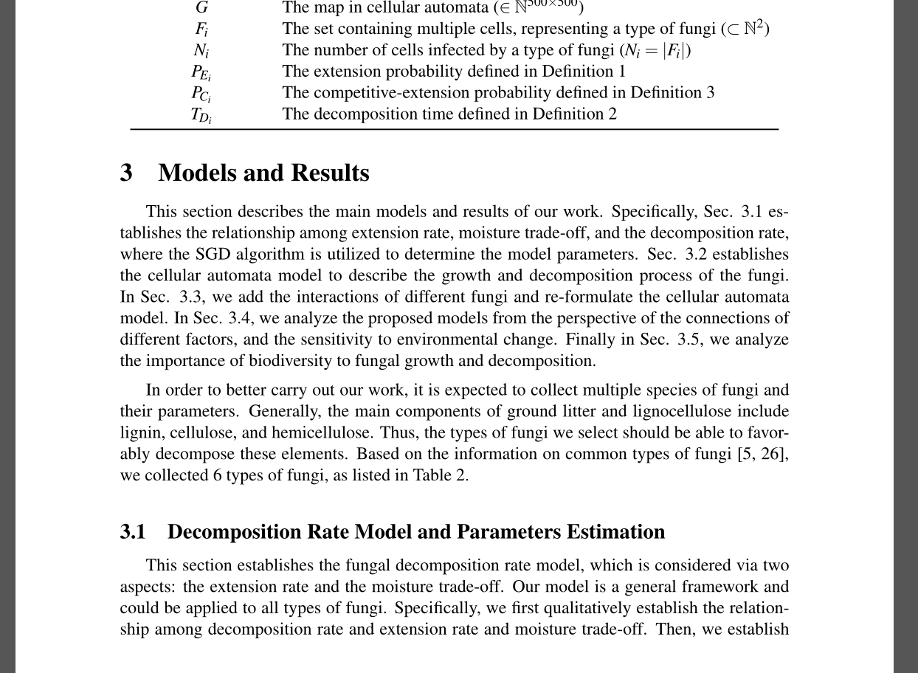
依然是先介绍每个部分做了什么，再依次详细说明

Slide 15
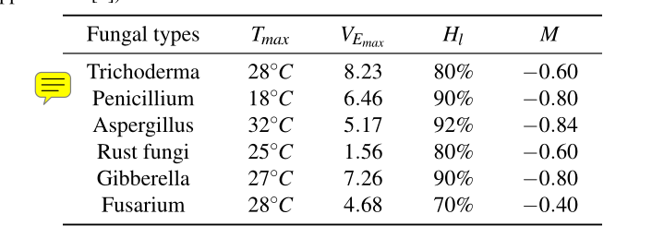
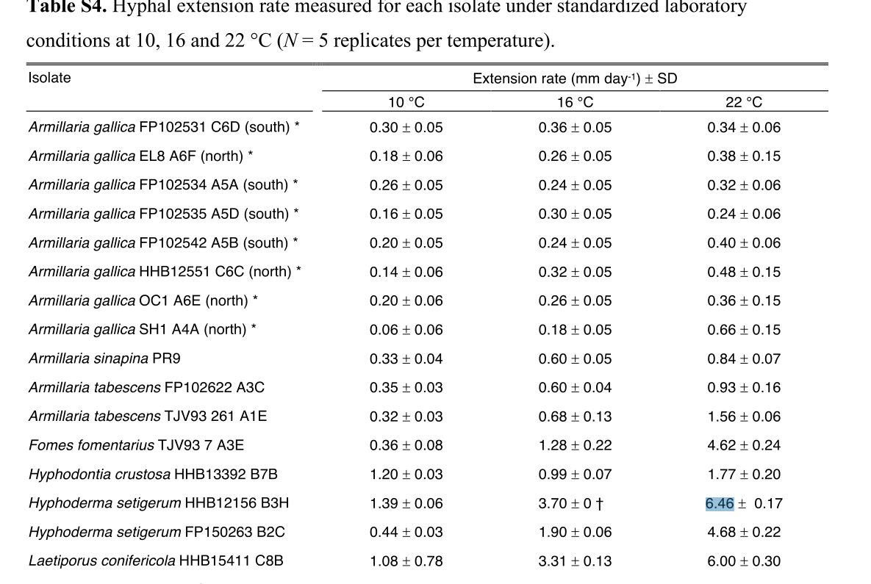

Slide 16
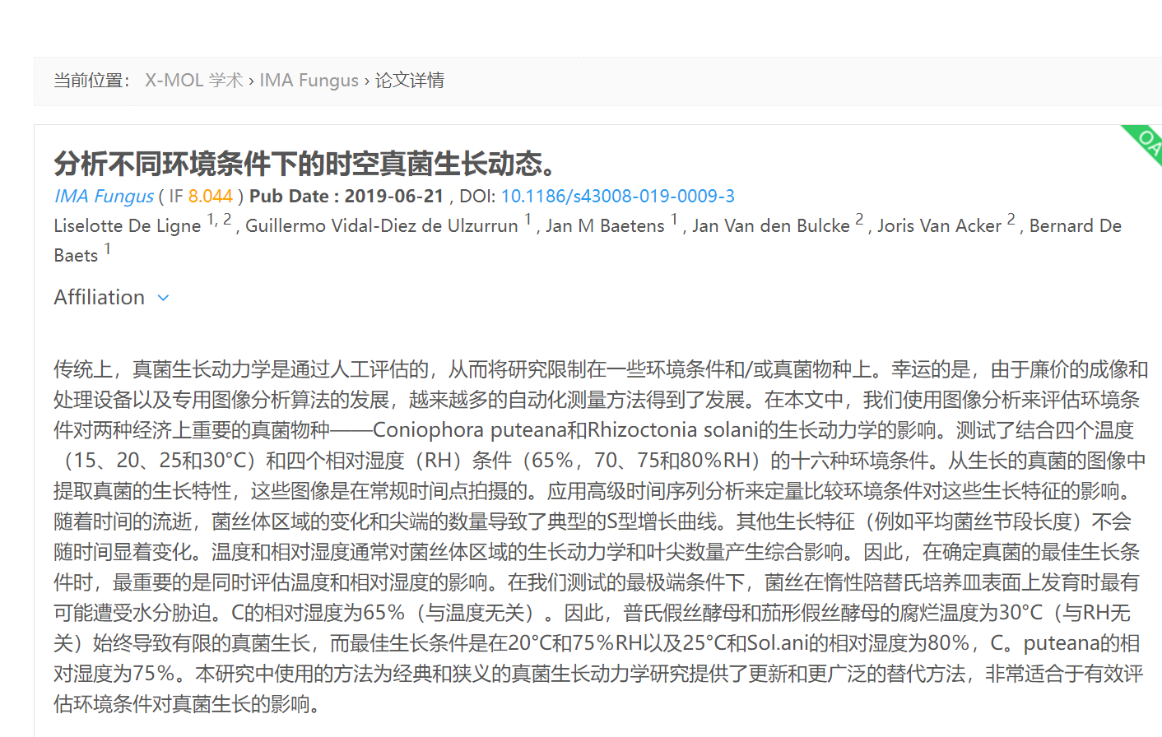

Slide 17
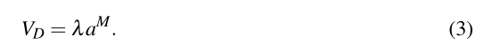
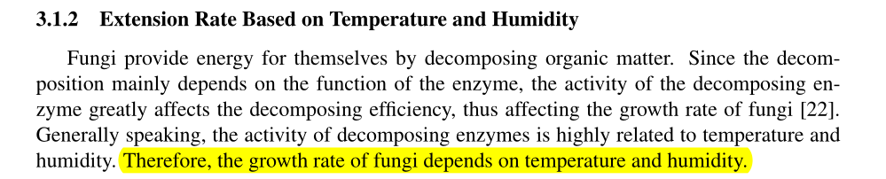
扩张速度
湿度
求和
对应前面的酶

Slide 18
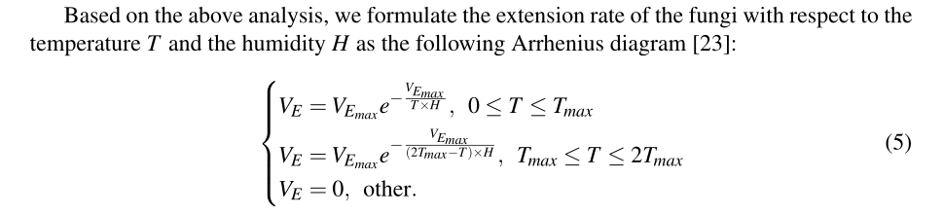
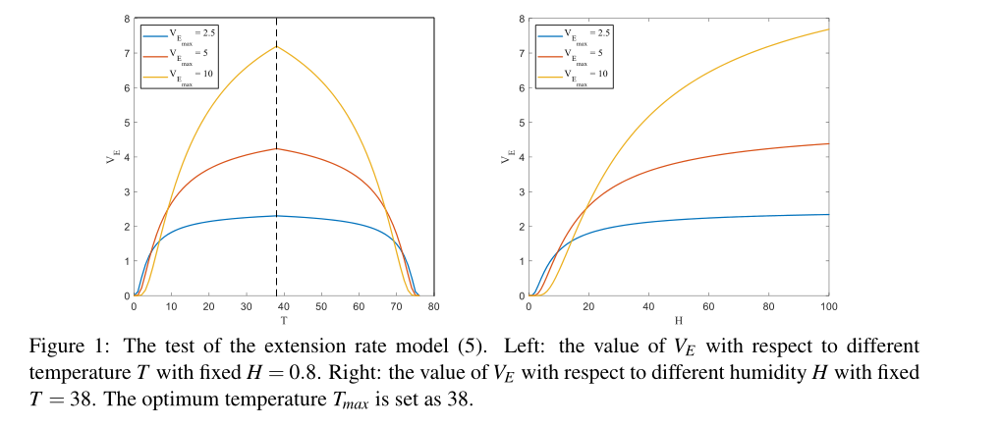
In order to illustrate the rationality of the above model (5), we display the value of VE with
respect to different T and H in Fig. 1. We can see that when the maximum extension rate
VEmax of the fungi is large, the fungi are sensitive to the change of environment (temperature and
humidity). For example, the yellow line in the Fig. 1 represents a maximum extension rate of
10. When the temperature or humidity changes a lot, the extension rate of these fungi is even
lower than that of the fungi with a maximum extension rate of 2.5, which is represented by the
blue line. That is to say, the fungi with a higher extension rate are not robust to the change of
environment. This phenomenon is consistent with the analysis in the literature [5].

Slide 20
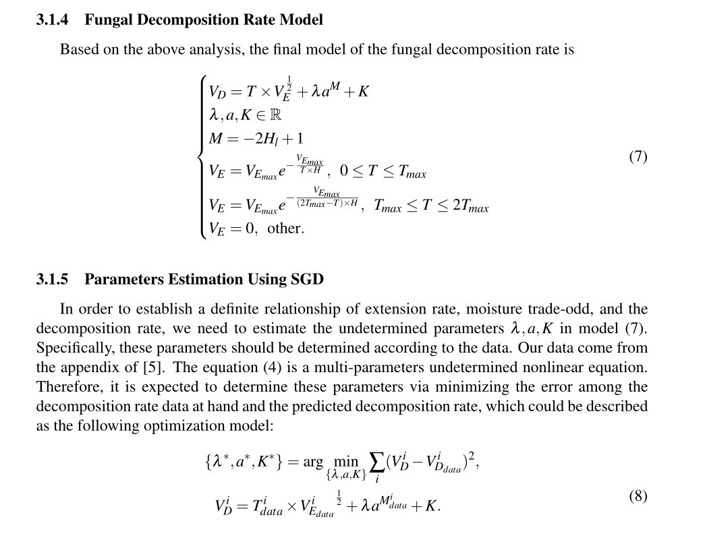

Slide 21
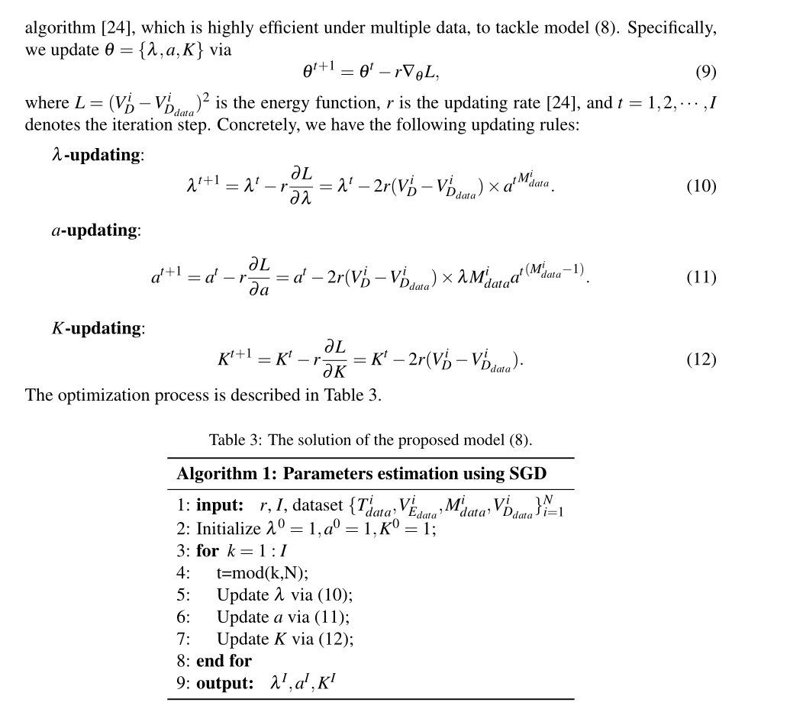

Slide 22
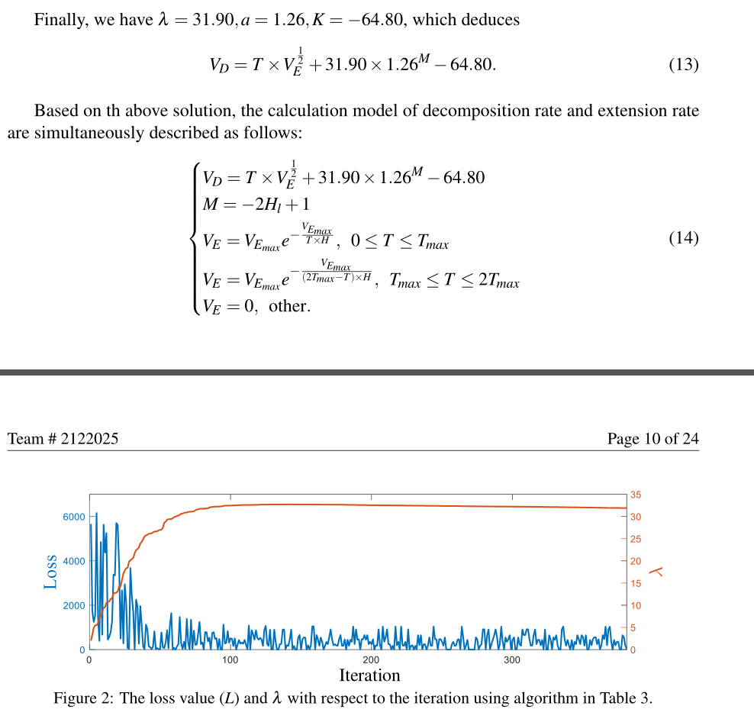

Slide 23
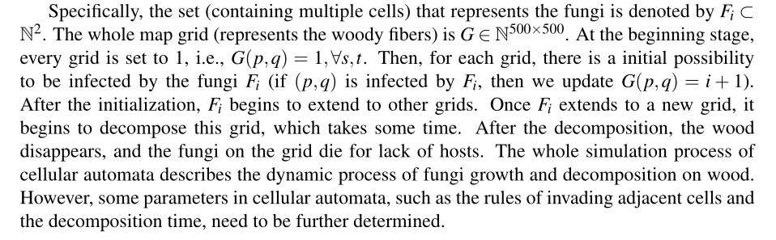
具体来说，表示真菌的集合（包含多个单元格）用 Fi ⊂ 表示氮气。 整个地图网格（代表木本纤维）为 G ∈ N500×500。 在起步阶段，每个网格都设置为 1，即 G(p,q) = 1,∀s,t。 那么对于每一个格子，都有一个初始的可能性被真菌 Fi 感染（如果 (p,q) 被 Fi 感染，那么我们更新 G(p,q) = i + 1）。
初始化完成后，Fi开始向其他网格扩展。 一旦 Fi 扩展到一个新的网格，它开始分解这个网格，这需要一些时间。 分解后的木头消失，网格上的真菌因缺少宿主而死亡。 整个仿真过程元胞自动机描述了真菌在木材上生长和分解的动态过程。然而，元胞自动机中的一些参数，如入侵相邻单元格的规则和分解时间，需要进一步确定。

Slide 24
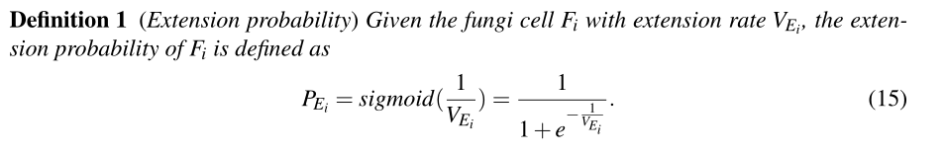
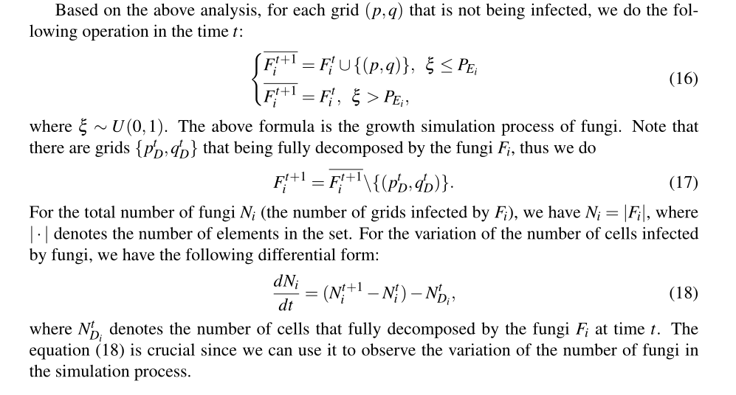

Slide 25
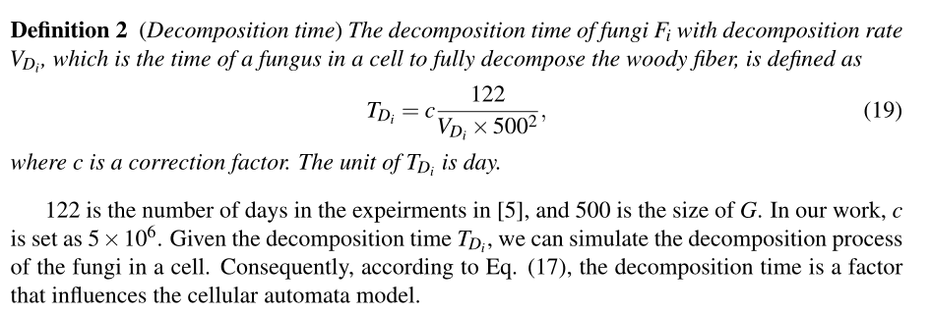

Slide 26
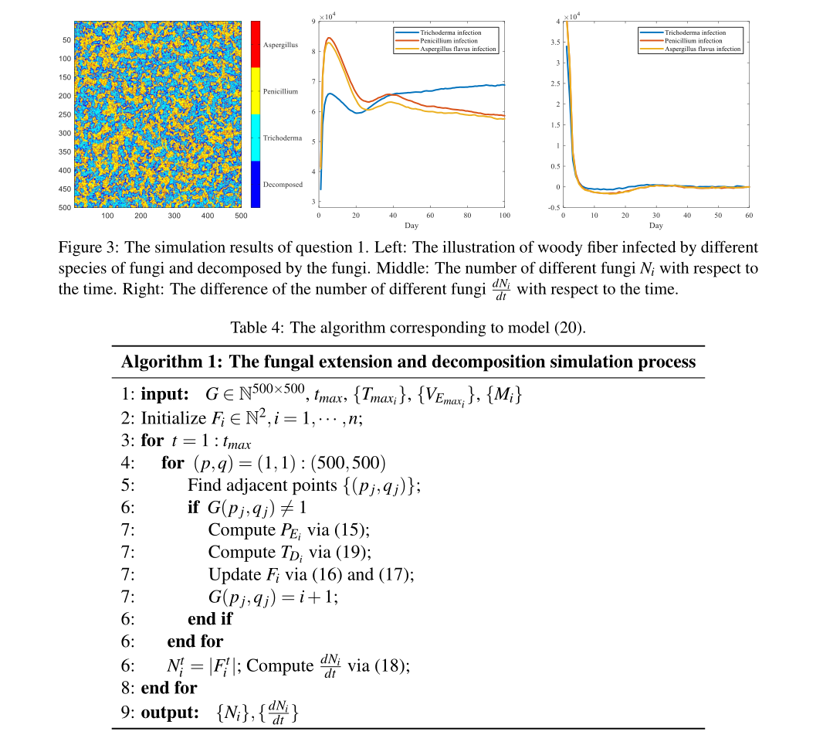

Slide 27
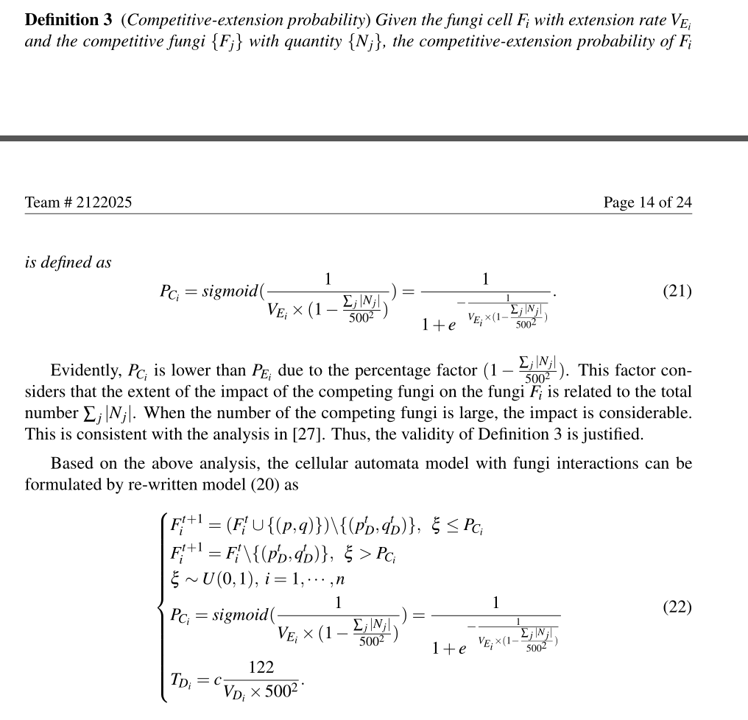
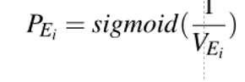
在模拟不同菌种之间的关系时，我们应该考虑两个方面:互利和互斥。然而，据我们所知，这种互惠仅存在于真菌与其他生物之间[27,28]。因此，当我们考虑真菌之间的关系时，主要考虑的是竞争关系。也就是说，在不同真菌的相互作用下，VE的延伸速率会降低。根据我们之前的工作(定义1)，扩展概率将发生变化。我们归纳出以下真菌相互作用下扩展概率的定义。
显然，由于百分比因素 (1 − ∑ j |Nj|5002)，PCi 低于 PEi。 该因子认为竞争真菌对真菌Fi的影响程度与总数∑j|Nj|有关。 当竞争真菌的数量很大时，影响是相当大的。 这与文献[27]中的分析一致。 因此，定义 3 的有效性是有道理的。

Slide 28
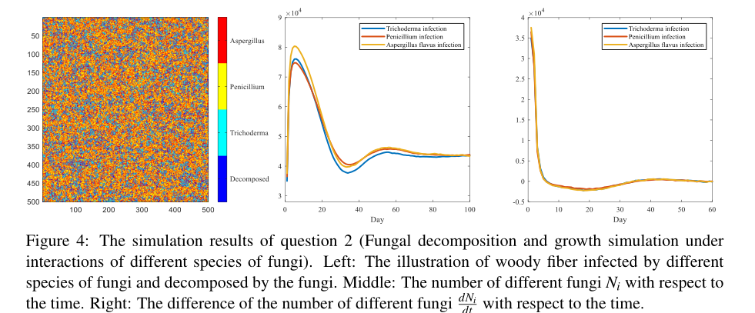
与第一个问题不同，我们在本节中考虑不同类型真菌之间的竞争。在这样的考虑下，我们的实验结果与第一个问题有很大的不同。具体来看，从图4的中间图可以看出，虽然真菌的整体生长趋势是先增加后减少，但真菌的总体数量与第一个问题的结果相比明显减少。这是因为我们考虑了真菌之间的竞争。根据定义3，真菌不太可能感染木材。因此，真菌的总体数量明显减少。

Slide 29
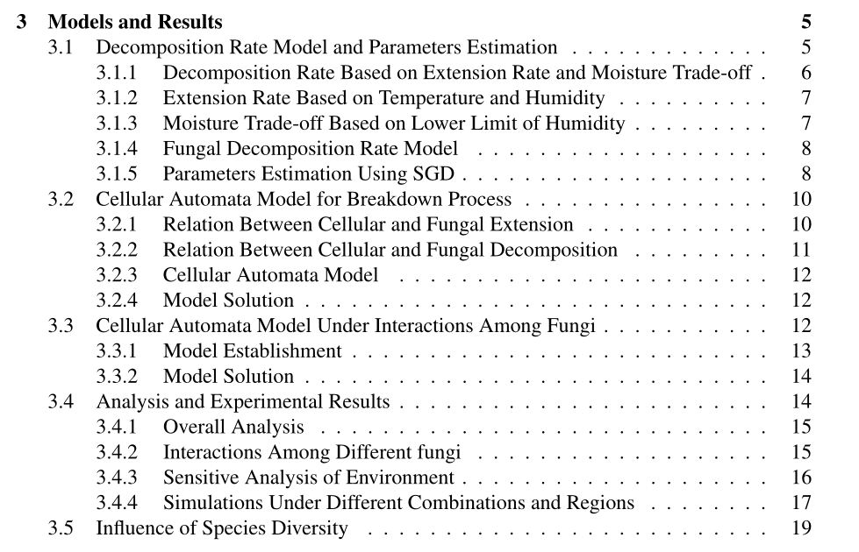
建模过程
数据拟合
建模过程
算法跑
建模过程
算法跑
使用已经建好的模型跑题目要求
多菌种组合
环境敏感性分析
多环境模拟
多样性分析

Slide 31
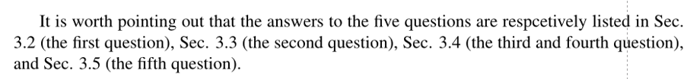
Sec. 3.1 establishes the relationship among extension rate, moisture trade-off, and the decomposition rate, where the SGD algorithm is utilized to determine the model parameters. Sec. 3.2 establishes the cellular automata model to describe the growth and decomposition process of the fungi.
In Sec. 3.3, we add the interactions of different fungi and re-formulate the cellular automata model. In Sec. 3.4, we analyze the proposed models from the perspective of the connections of different factors, and the sensitivity to environmental change. Finally in Sec. 3.5, we analyze the importance of biodiversity to fungal growth and decomposition.
第3.1节建立了扩展速率、水分交换和分解速率之间的关系，其中SGD算法用于确定模型参数。章节3.2建立细胞自动机模型来描述真菌的生长和分解过程。
在第3.3节中，我们添加了不同真菌的相互作用，并重新制定细胞自动机模型。在第3.4节中，我们从不同因素之间的联系以及对环境变化的敏感性角度分析了所提出的模型。最后在第3.5节，我们分析了生物多样性对真菌生长和分解的重要性。

Slide 32
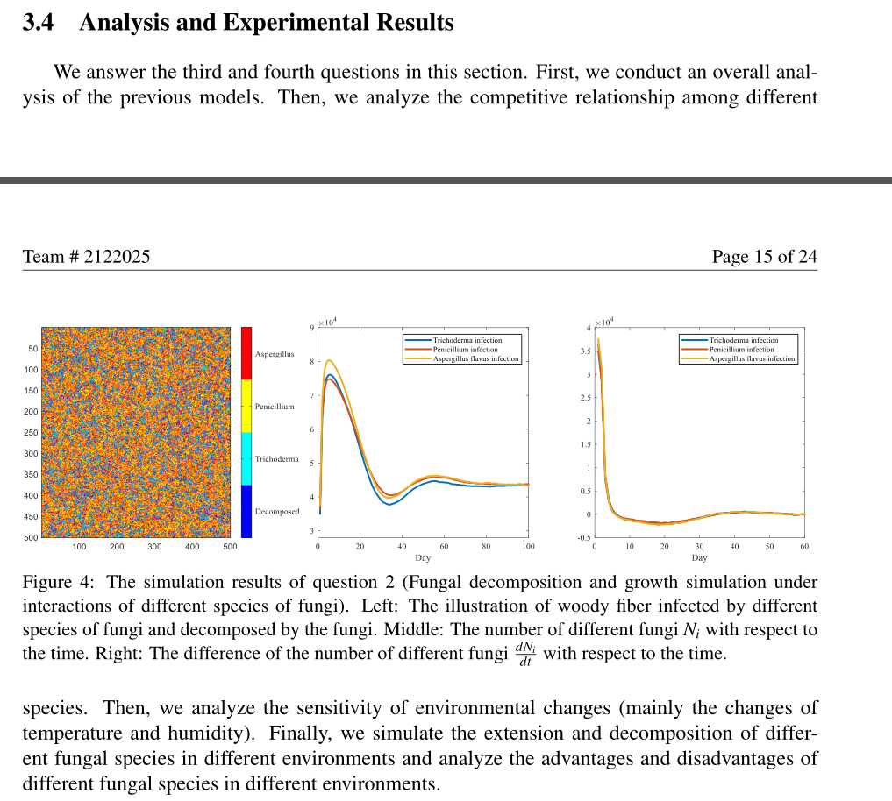
介绍这一小节都干了什么
首先，我们对之前的模型进行整体分析。 然后，我们分析了不同物种之间的竞争关系。 然后，我们分析了环境变化的敏感性（主要是温度和湿度的变化）。 最后，我们模拟了不同真菌种类在不同环境中的延伸和分解，分析了不同真菌种类在不同环境中的优缺点。

Slide 33
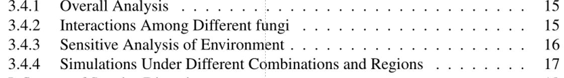
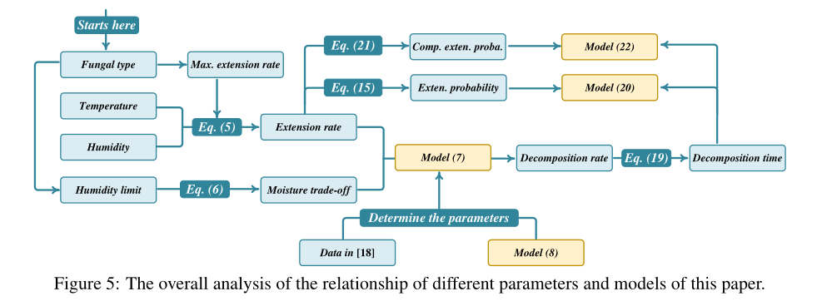
模型怎么建立的

Slide 34
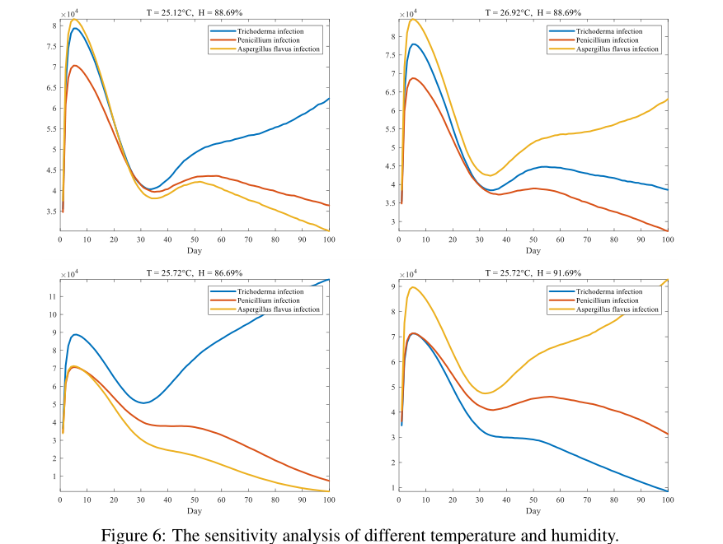

Slide 35
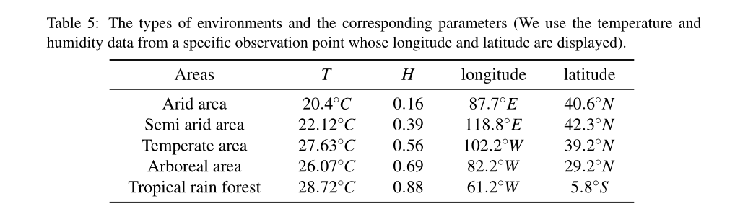
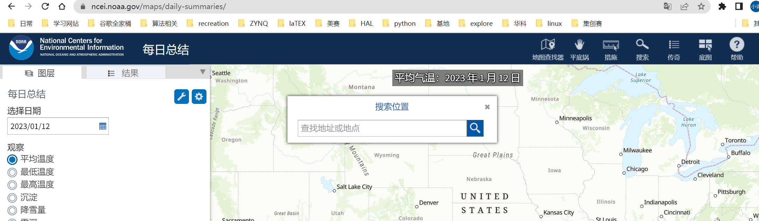

Slide 36
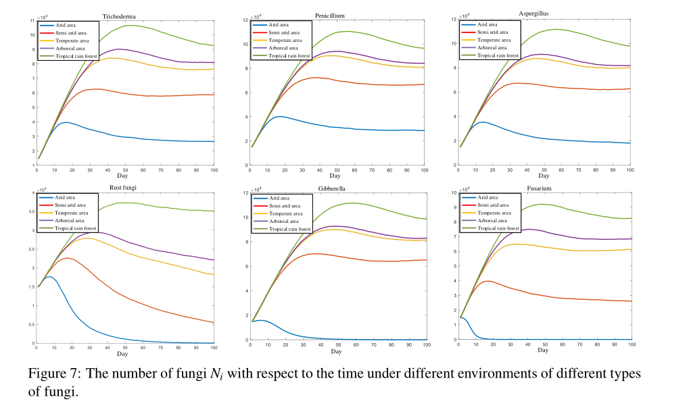

Slide 37
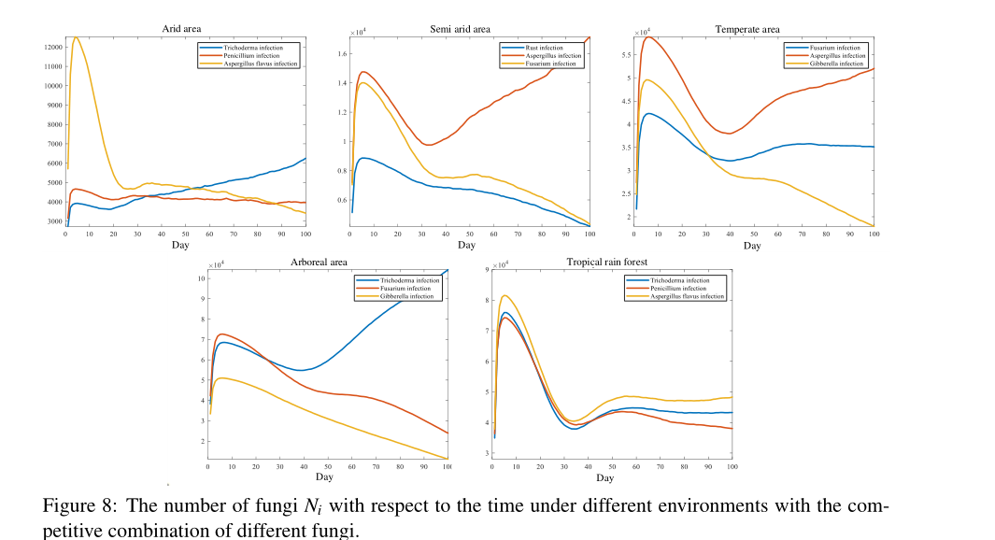

Slide 38
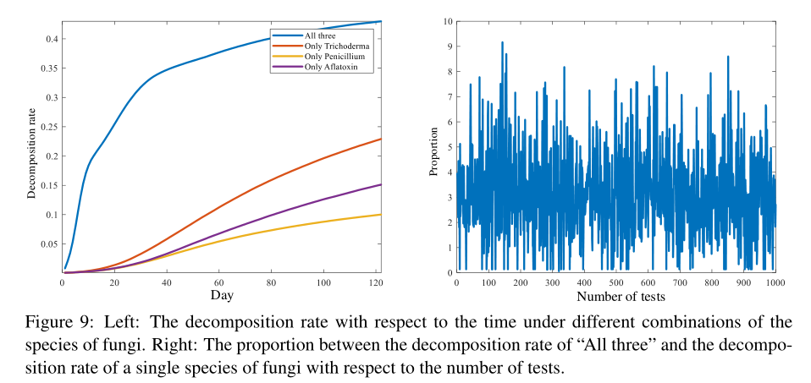
Specifically, the average proportion is 2.89.

Slide 39
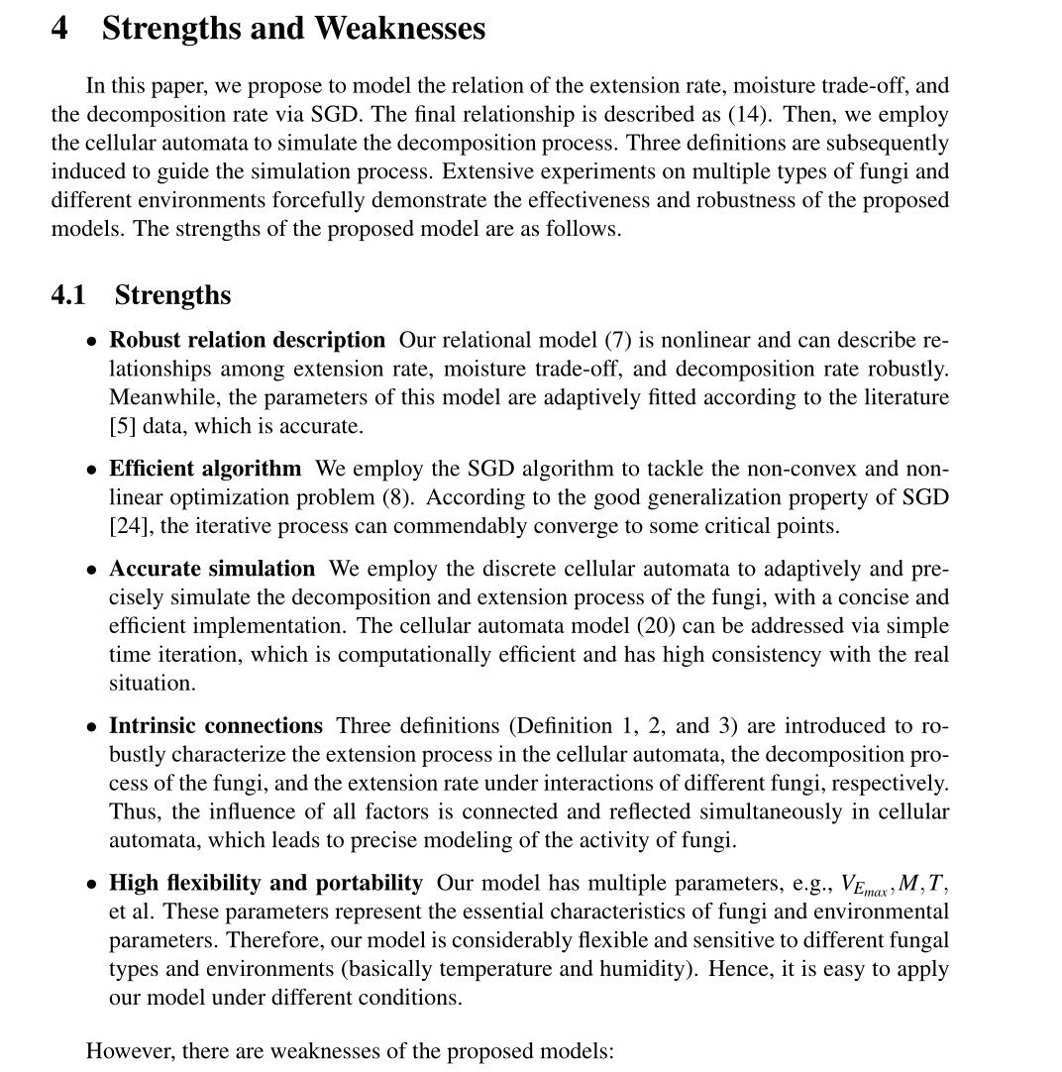
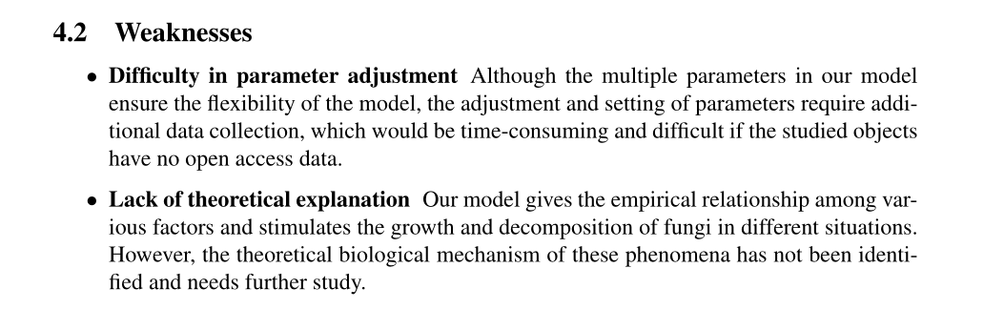

Slide 40
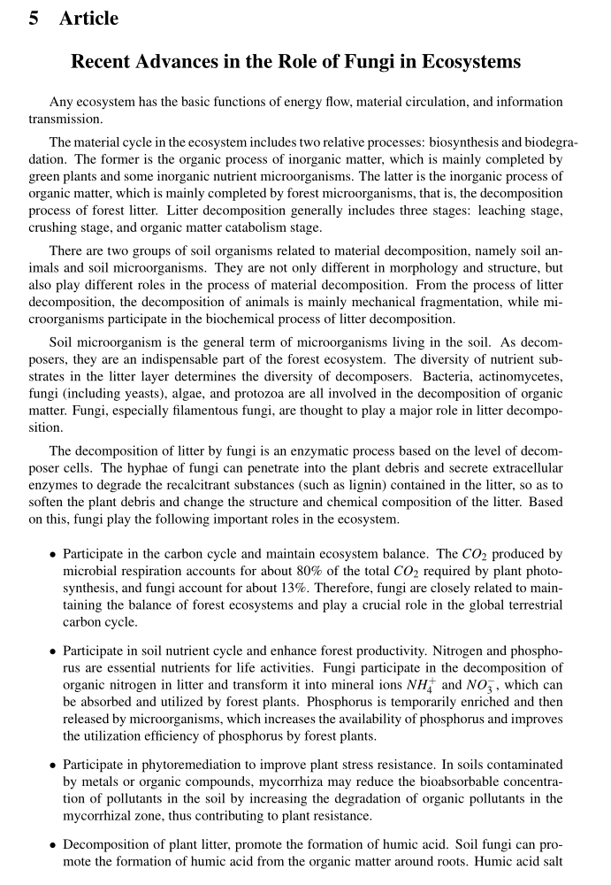
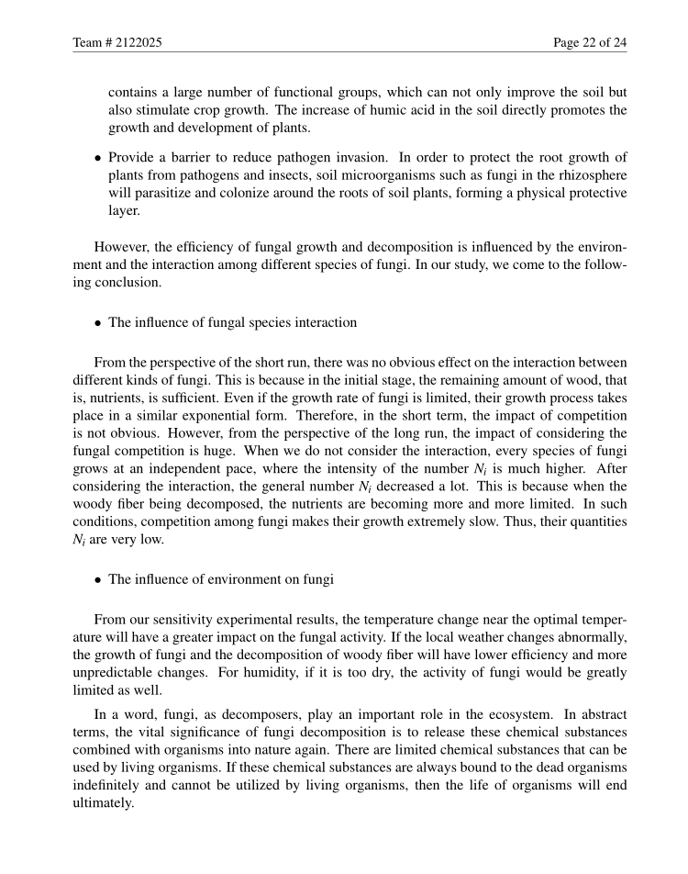
他们的分析
作用

Slide 41
优点：
整个模型建立过程十分详细完整，有理有据。
模型通俗易懂，实现难度较低。
大量使用了总分，分总的写法，使得文章的结构一遍遍被强化
除了综述部分，只引用了几篇文献，好处是不用贴代码
有综述显得专业
交叉引用充分
缺点：
排版较为随意，有些图片的位置属实离谱
数据的来源不太靠谱的感觉

Slide 42
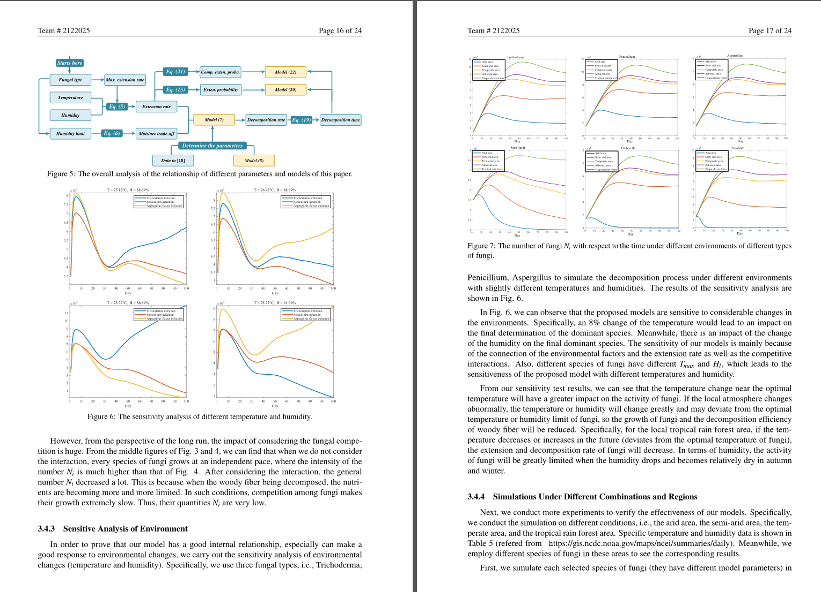

Slide 43
2021A 2120808
华丽之作
GAME: A Seer on Fungi Living Strategies and
Biodiversity Based on Gause’s Model

Slide 44
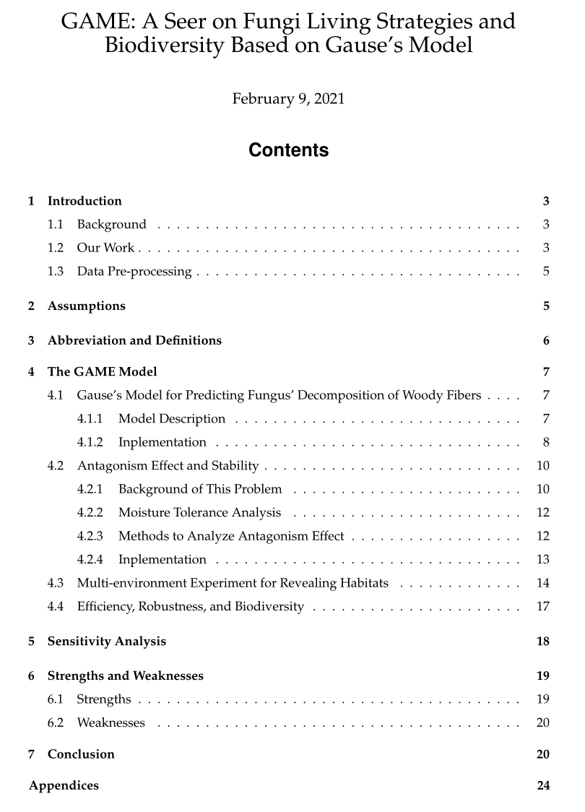

Slide 45
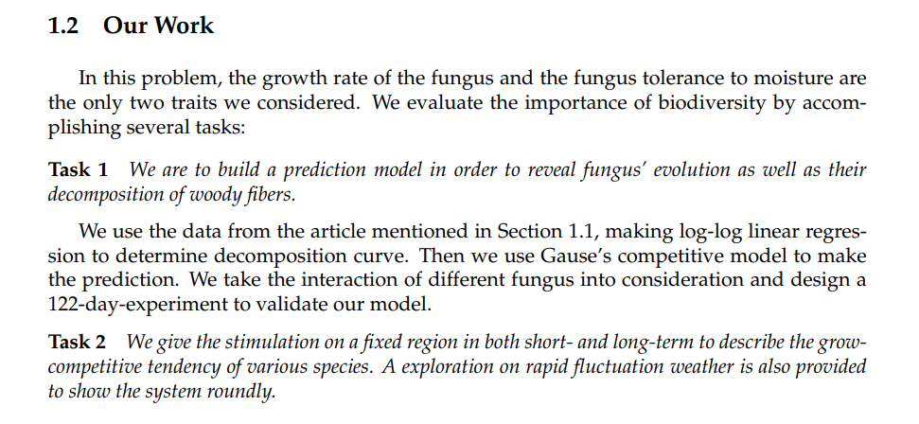
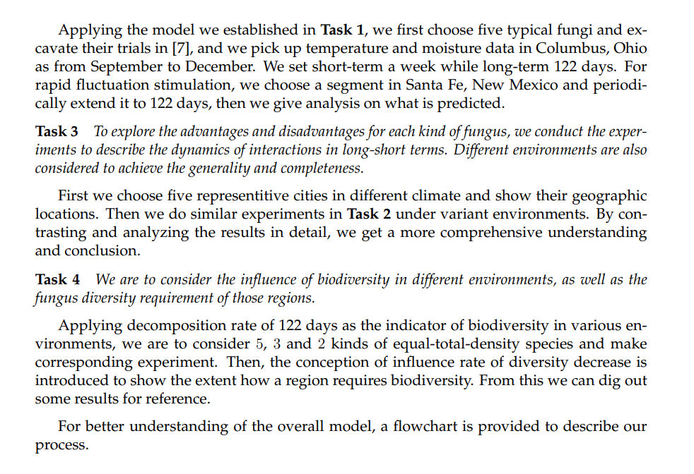
比较1：第一节的回顾题目可以跟自己的工作结合起来写。
上一篇没这么做是因为他们的工作有受到综述的贡献。

Slide 46
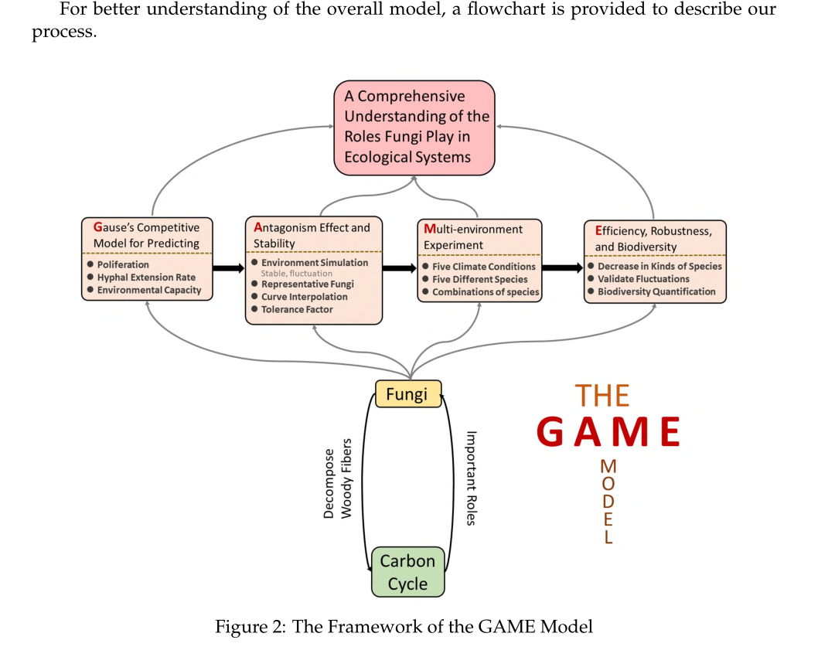
亮点1：给自己的模型起了个厉害的名字，厉害的感觉

Slide 47

亮点2：
数据来源相对可靠，由原材料论文中的数据获得，
经过LS回归计算得到结果

Slide 48

个人感觉这篇文章的更清晰

Slide 49




Slide 50

亮点3：图片丰富

Slide 51


Slide 52


Slide 53




Slide 54



Slide 55


sfwef

Slide 56
样本选取

Slide 57


Slide 58
湿度分析

Slide 59

说明与例子相结合

Slide 61

采用插值获取数个温度的数据
此外，为了达到更好的普适性，我们将斜率 λ 设置为 0.44，这是 log（几何平均分解率）在 10°C、16°C、22°C ∼ log（菌丝延伸率）之间的回归系数。

Slide 62

亮点4：
表达水准高
From those curves above, we are able to analyse how different fungi grow and compete
to each other. Some meaningful results are refined below:
From this graph, we are able to observe that
By analyse the changing tendency in the gragh above, we can derive the following significant conclusions:
Dynamics of the interactions in long-term trends is shown in Figure 19. We can make the following conclusions:
The estimation for the decomposition rates, given the growth rate, is shown in Figure 3, each triangle represents a fungal isolate.
Short-term and long-term climate trend including temperature and humidity in Columbus are shown in Figure 11 and Figure 12.
Our model gives the predicitons of decomposition amount in 122 days, which is shown below.
Figure 8 demonstrates the hyphal extension rate of five different species changed by temperature. Figure 9 shows the hyphal extension rate of five different species changed by water potential. Each Species’ strength and weakness are shown in Figure 10.
In the left cube (light green color), total species density is high. Consequently, their generative hyphaes meet and interact with each other. In the right cube (dark green color), there exists no competition as total species density is low.

Slide 63

承上启下
有意义的结果
对结果的分析：
1.结果的改进方案
2.结果的现实对照

Slide 64


Slide 65


Slide 66

亮点5：
对不同环境下数据的验证分析，
相比上一篇文章只做了同一环境中多样性分析，这篇文章还对不同环境对多样性的要求做出了量化的分析

Slide 67


模型鲁棒性分析

Slide 68
Strong Universality. Our model is mainly based on a classical Gause’s model, which
is used to revealing how species have interactions with each other, particularly for
micro-organism like fungi. Indeed, we can also apply this to some associated pre-
diction, like the proliferation, competition as well as reciprocal of different species.
Namely , once we obtain the initial data as well as all personal features, environmental
parameters, and how they evolve in the future, a reasonable and robust prediction will
be presented.
Precise Interpretability. The result reveals that our model performs well since it is
consistent with our common sense and biological explanation. Moreover, results of
some academic articles in micro-organism field can also vindicate the predicted con-
clusion wherever those fungi species live.
High Accuracy. Since fungi’s competition will be quite sensitive to outside circum
stance, especially for fluctuation of timely temperature and moisture, our model can
accomplish this sensitivity which can be rapidly reflected on predicted result.

Slide 69


Slide 70



Slide 71


Slide 72
亮点1：
给自己的模型起了个厉害的名字，厉害的感觉
亮点2：
数据来源相对可靠，由原材料论文中的数据获得，
亮点3：
图片丰富
亮点4：
表达水准高
亮点5：
对不同环境下数据的验证分析，
相比上一篇文章只做了同一环境中多样性分析，这篇文章还对不同环境对多样性的要求做出了量化的分析
缺点：
模型较为简陋，得到的过程不如上一篇富有逻辑性。
Article模糊
模型调参难度会很大

Slide 73
小结：
有非常明确的结论，并在文章相应位置展示
完全完成了所有要求任务
有高质量的图片
写作结构框架齐整，有论文综述这种高质量内容
框架搭建有数据支撑，基本不存在纯粹的想象
结果验证有根据，
这题主要是与题目中的文章相一致，与常识（科学常识）相一致

Slide 74
1.上文的那个代码
2.Matlab的一个工具
3.Pdf拼接工具
4.图片集合

Slide 75
到20日为止的安排：
1、完成2021D的一个latex论文复现
2、上文的相关阅读报告
3、2020A的1篇论文阅读报告

